Slide 1
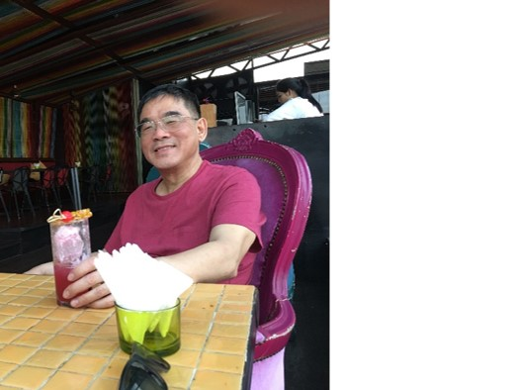
Database Lab 11
Advanced SQL
Triggers
Addendum
Dr. Jefferson Fong

Slide 2
Assignment 3 due Sunday 14 December, right before midnight.
On Presentation – see Lec12 Addendum.pptx
  Also see iSpace Course Project folder
    Project Requirement
    Presentation Guideline.
Everyone is required to attend and evaluate half of other teams.
  Need to attend and evaluate 7 other presentations.

Slide 3
Presentation Schedule
Data and Time | Team
Wed 17 Dec, 10-11 | 5, 9, 8
Wed 17 Dec, 11-noon | 3, 2, 11, 14
Thu 18 Dec, 4:20-5 | 6, 1, 15
Thu 18 Dec, 5-6 | 10, 7, 4, 12
Thu 18 Dec, 6-6:15 (1 team) | 13

Slide 4
Slide 3
Last lab, we’ve learned CHECK (e.g. GPA must be from 0 to 4) for one table.
For complicated predicate across multiple tables, we use TRIGGER.
  Any modification to the DB triggers the process specified.
Slide 7
When delete the p_code from program, we also must delete p_code from student.
Last lab’s way (top) versus using trigger (bottom).
  Both ways are OK for something this simple.

Slide 5
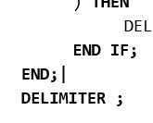
Slide 9
Delete the new row if its gpa < 1.0 and p_name is CST
Run the example.
In the last line, there must be a space between DELIMITER and ;
Slide 10
Exercise 1, mimic the example in Slide 9.
Exercise 3, from the uic.sql database,
  Schema for enroll(id, c_name, s_number, sem, grade)
  Schema for course(c_name, credit, domain, c_number)
  Need enroll JOIN course USING (c_name)

Slide 6


